Slide 1
Replenishment
WMS Guide

Slide 2
Table of Contents
Replenishment with a Mobile Device……………………………………………………………………..3
System-Directed ..….........................................................................................3
Replenish by Section...………............................................................................9
Replenish by Area………..……..........................................................................13
Replenish by Location………….........................................................................17
Wave Replenishment Management……………………………………………………………………..21

Slide 3
Replenishment with a Mobile Device
System-Directed

Slide 4
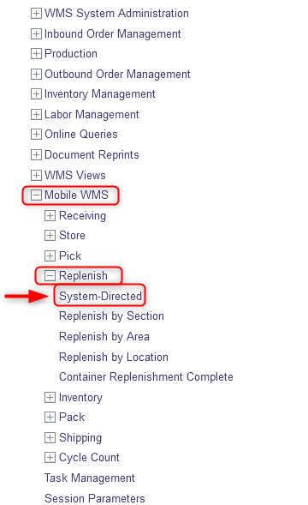
System-Directed
The user may choose to perform system-directed replenishment, where the system specifies what location is to be replenished. The system-directed resource will display the replenishment in order of priority based on the command sequences. To do this:
With a mobile device, select the Replenish resource.
Under Replenish, click on System-Directed.

Slide 5
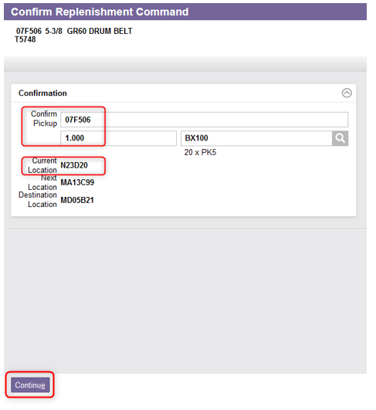
System-Directed
From the new window, go to the location specified in the Current Location field.
Take the product specified in the required quantity.
Enter or scan the product in the Confirm Pickup field to confirm that it has been taken.
Click Continue.

Slide 6
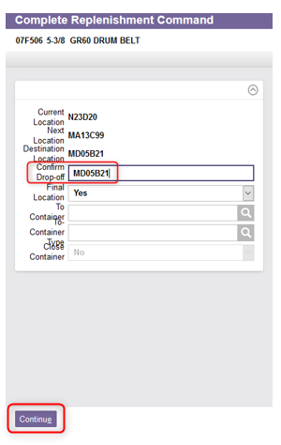
System-Directed
On the second window, confirm the replenishment by scanning or entering the Drop-off point.
Click Continue.

Slide 7
System-Directed
Repeat steps 3 to 8 for any further replenishments.
Once all commands have been processed, the system will display the following message:

Slide 8
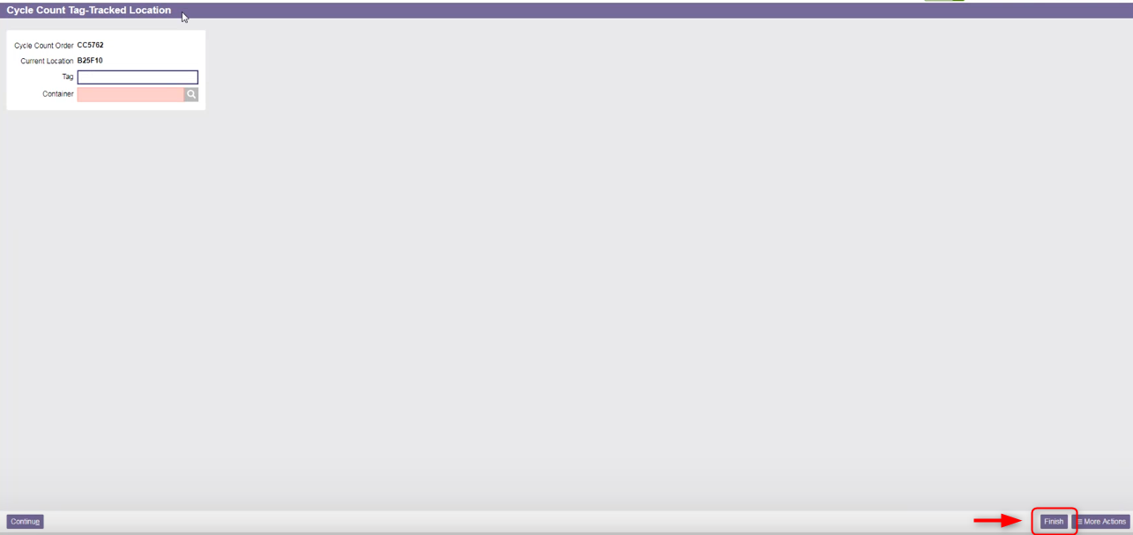
System-Directed
Additional Note – Depending on the configuration of the system administration, if a location has been emptied following a replenishment, a cycle count may be generated to validate that this location is really empty. Confirm that the location is empty by clicking on Finish.

Slide 9
Replenishment with a Mobile Device Replenish by Section

Slide 10
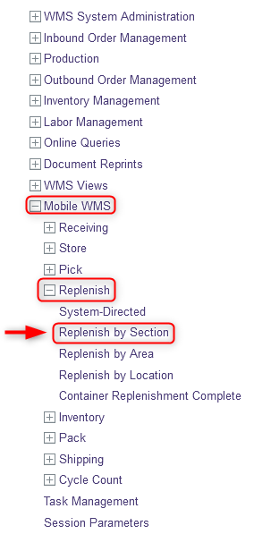
Replenish by Section
The user may choose to replenish one or more specific sections in the warehouse. To do this:
With a mobile device, select the Replenish resource.
Under Replenish resource, click on Replenish by Section.

Slide 11
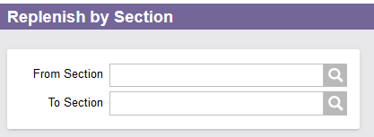
Replenish by Section
From the new window, the user has the following options:
  Option 1: Enter a section in the From Section field and all the replenishment commands that originate from that section are retrieved.
  Option 2: Enter a section in the To Section field and all the replenishment commands that are destined to that section are retrieved.
  Option 3: Enter a section in the From Section and To Section fields and all the replenishment commands that originate from the From section and go to the To section are retrieved.

Slide 12
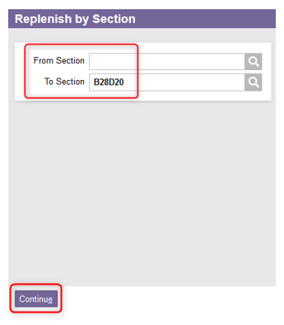
Replenish by Section
  Once the fields are filled, click Continue.
  The steps are then the same as for System-Directed. Refer to steps 3 to 8 of the “System-Directed“ section for the rest of this procedure.

Slide 13
Replenishment with a Mobile Device Replenish by Area

Slide 14
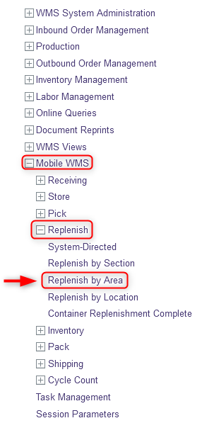
Replenish by Area
The user may choose to replenish one or more specific areas in the warehouse. To do this:
With a mobile device, select the Replenish resource.
Under Replenish resource, click on Replenish by Area.

Slide 15
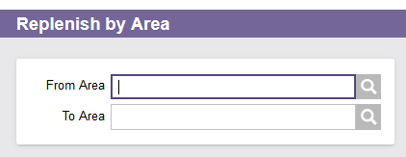
Replenish by Area
From the new window, the user has the following options:
  Option 1: Enter an area in the From Area field and all the replenishment commands that originate from that area are retrieved.
  Option 2: Enter an area in the To Area field and all the replenishment commands that are destined to that area are retrieved.
  Option 3: Enter an area in the From Area and To Area fields and all the replenishment commands that originate from the From area and go to the To area are retrieved.

Slide 16
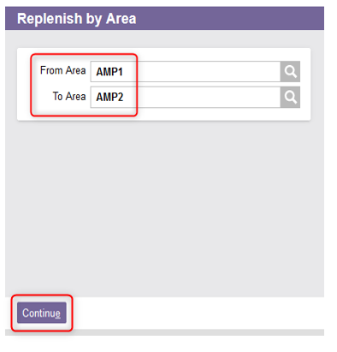
Replenish by Area
  Once the fields are filled, click Continue.
  The steps are then the same as for System-Directed. Refer to steps 3 to 8 of the “System-Directed“ section for the rest of this procedure.

Slide 17
Replenishment with a Mobile Device Replenish by Location

Slide 18
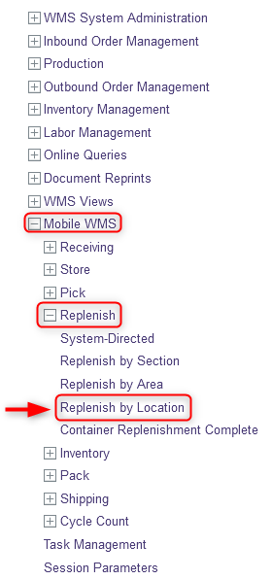
Replenish by Location
The user may choose to replenish one or more specific areas in the warehouse. To do this:
With a mobile device, select the Replenish resource.
Under Replenish resource, click on Replenish by Location.

Slide 19
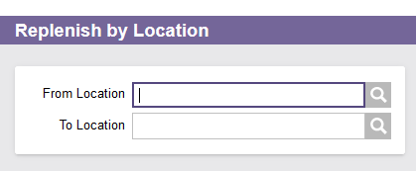
Replenish by Location
From the new window, the user has the following options:
  Option 1: Enter a location in the From Location field and all the replenishment commands that originate from that location are retrieved.
  Option 2: Enter a location in the To Location field and all the replenishment commands that are destined to that location are retrieved.
  Option 3: Enter a location in the From Location and To location fields and all the replenishment commands that originate from the From location and go to the To location are retrieved.

Slide 20
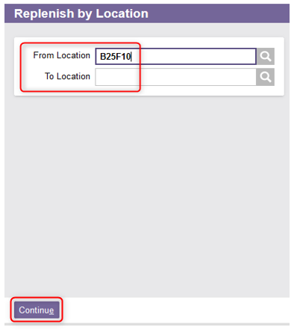
Replenish by Location
  Once the fields are filled, click Continue.
  The steps are then the same as for System-Directed. Refer to steps 3 to 8 of the “System-Directed“ section for the rest of this procedure.

Slide 21
Wave Replenishment Management

Slide 22
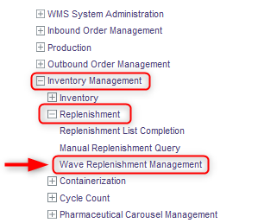
Wave Replenishment Management
You also have the option to create a replenishment wave directly from a desktop computer. To do this:
With a desktop computer, select the Inventory Management resource.
Under Inventory Management, click on Replenishment.
Under Replenishment, click on Wave Replenishment Management.

Slide 23
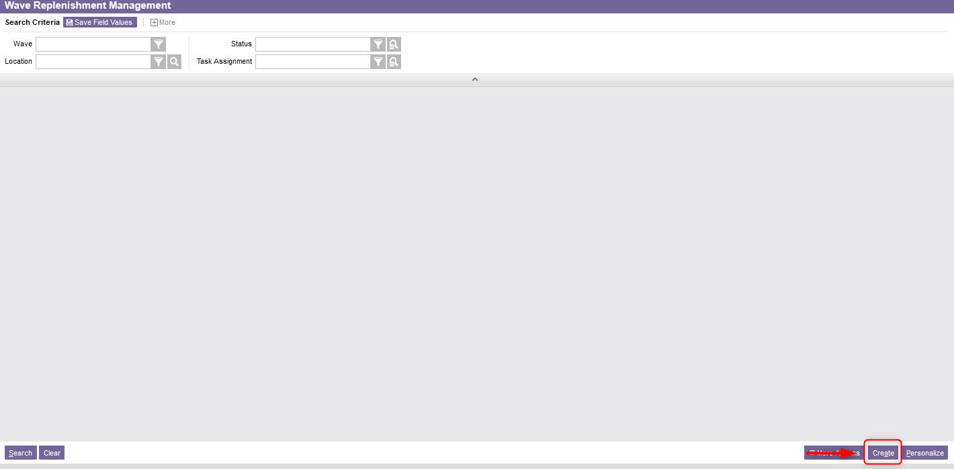
Wave Replenishment Management
Select the Create action at the bottom right corner of the screen.

Slide 24
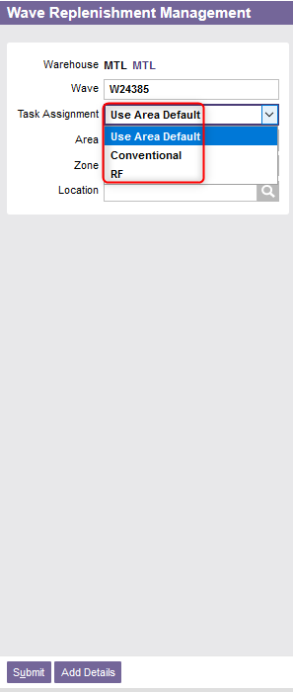
Wave Replenishment Management
From the new window, the next available wave number for the replenishment wave will be displayed.
Change the Task Assignment is necessary.
    If “Conventional” is selected, the replenishment will be performed with a paper-based list;
    If “RF” is selected, the replenishment will be performed using a mobile device.

Slide 25
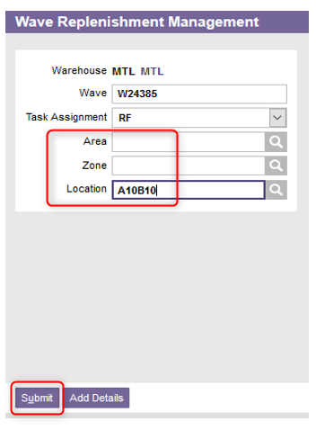
Wave Replenishment Management
Enter one of the following options:
  Area
  Zone
  or Location
Click Submit.
The wave of replenishment has been created. You can then perform the replenishment using mobile device by referring to the steps explained previously.

